Slide 1

SCHOOL OF COMPUTING, ENGINEERING, AND DIGITAL TECHNOLOGIES
Module Title : Artificial Intelligence Foundations
Module Code : CIS4049-N
Module Leader : Dr Alessandro Di Stefano
ASSIGNMENT TITLE : WAREHOUSE ROBOT OPTIMIZING USING REINFORCEMENT LEARNING
PRESENTING BY : PALLAVIRANGANATHA
S3417639

Slide 2
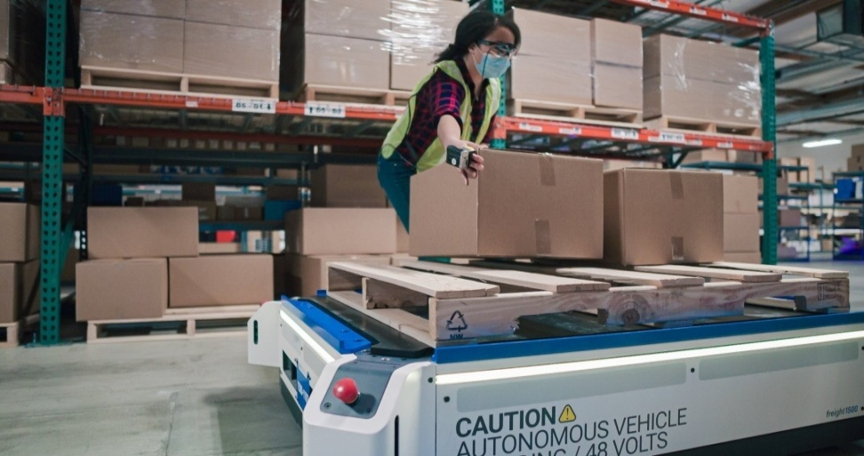
WAREHOUSE ROBOT OPTIMIZING USING REINFORCEMENT LEARNING
PALLAVI RANGANATHA
Student ID : S3417639

Slide 3
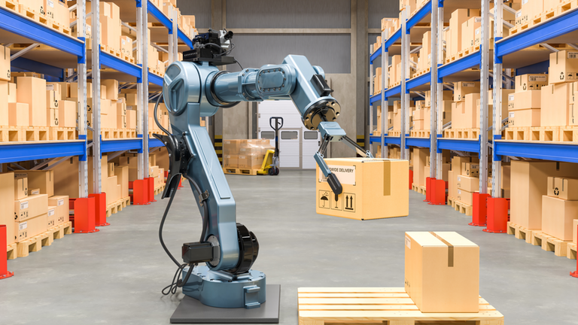
Introduction
This paper explores the application of Reinforcement Learning in optimizing warehouse robots, Warehouse robots perform tasks such as picking and delivering items in complex, dynamic environments.
Reinforcement learning (RL) provides a powerful approach for training robots to make optimal decisions through interaction with the environment.
In this case, RL algorithms such as Q-learning can learn strategies.
DQN is a cost-based algorithm that uses artificial neural networks.
PPO is a policy-based algorithm designed for continuous execution space.

Slide 4

Importing Necessary Libraries
The libraries relevant to the training and evaluation of the WAREHOUSE ROBOT OPTIMIZING USING REINFORCEMENT LEARNING
The libraries include
Num Py
Random
OpenAI Gym
Stable Baselines3
OpenCV

Slide 5
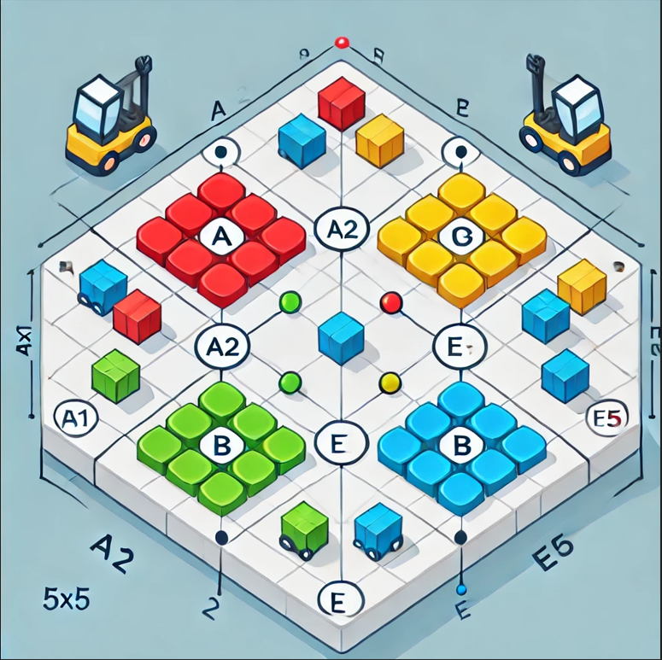
Defining The Environment
This Gym library provides an interface for interacting with theWarehouse robot optimizing.
State Space : 25× s (4+1) =125
possible states (for one robot).
Action Space: 3 Actions.
Rewards:
Move (UP/DOWN/LEFT/RIGHT) : No reward.
Pick a Task (PICK): +10 reward .
Drop a Task (DROP): +5 reward .
Idle Time (No Task): Penalty.
Collision: -5 penalty .

Slide 6
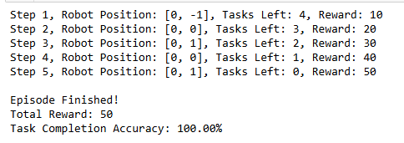
Reinforcement Learning Agent (RL Agent)
The robot's movement between positions indicates strategic navigation, ensuring task completion with 100% accuracy.
This flawless performance highlights the effectiveness of the reinforcement learning algorithm in optimizing task execution and maximizing rewards.

Slide 7
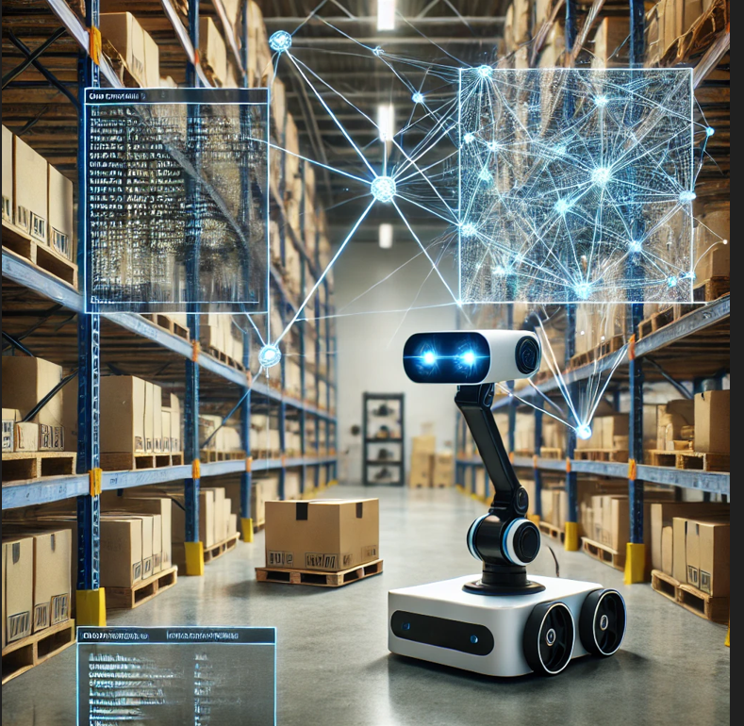
Image Processing Agent:
The Image Processing Agent detects items in the warehouse. It uses a pre-trained Convolution Neural Network (CNN) model to analyze images captured by the robot camera and accurately identify objects. The agent provides this information to the RL agent, which uses it to decide the next action

Slide 8
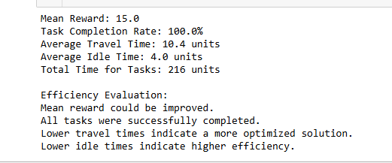
Evaluation Summary
The evaluation shows an average award of 15.0 with a task completion rate of 100%, indicating successful performance. The average travel time of 10.4 units reflects efficient movement

Slide 9
Conclusion And Limitations
This project demonstrates the significant potential of reinforcement learning (RL) to enhance the performance of warehouse robots.
where custom RL agents integrated with image processing for Remember items Increase efficiency and accuracy in picking and delivering goods, etc. RL agents learn the most appropriate strategies.
This requires resolving constraints, such as irregular object shapes and changing lighting conditions. DQN, A3C, Future work focuses on optimizing RL algorithms, such as TRPO and advanced deep learning models,, such as YOLO and Faster R-CNN will be explored to improve object recognition.
Another challenge was debugging and troubleshooting the code. Several times, I ran into issues with my implementation, and it took some trial and error to figure out what was going wrong and how to fix it.

Slide 10


